Slide 1
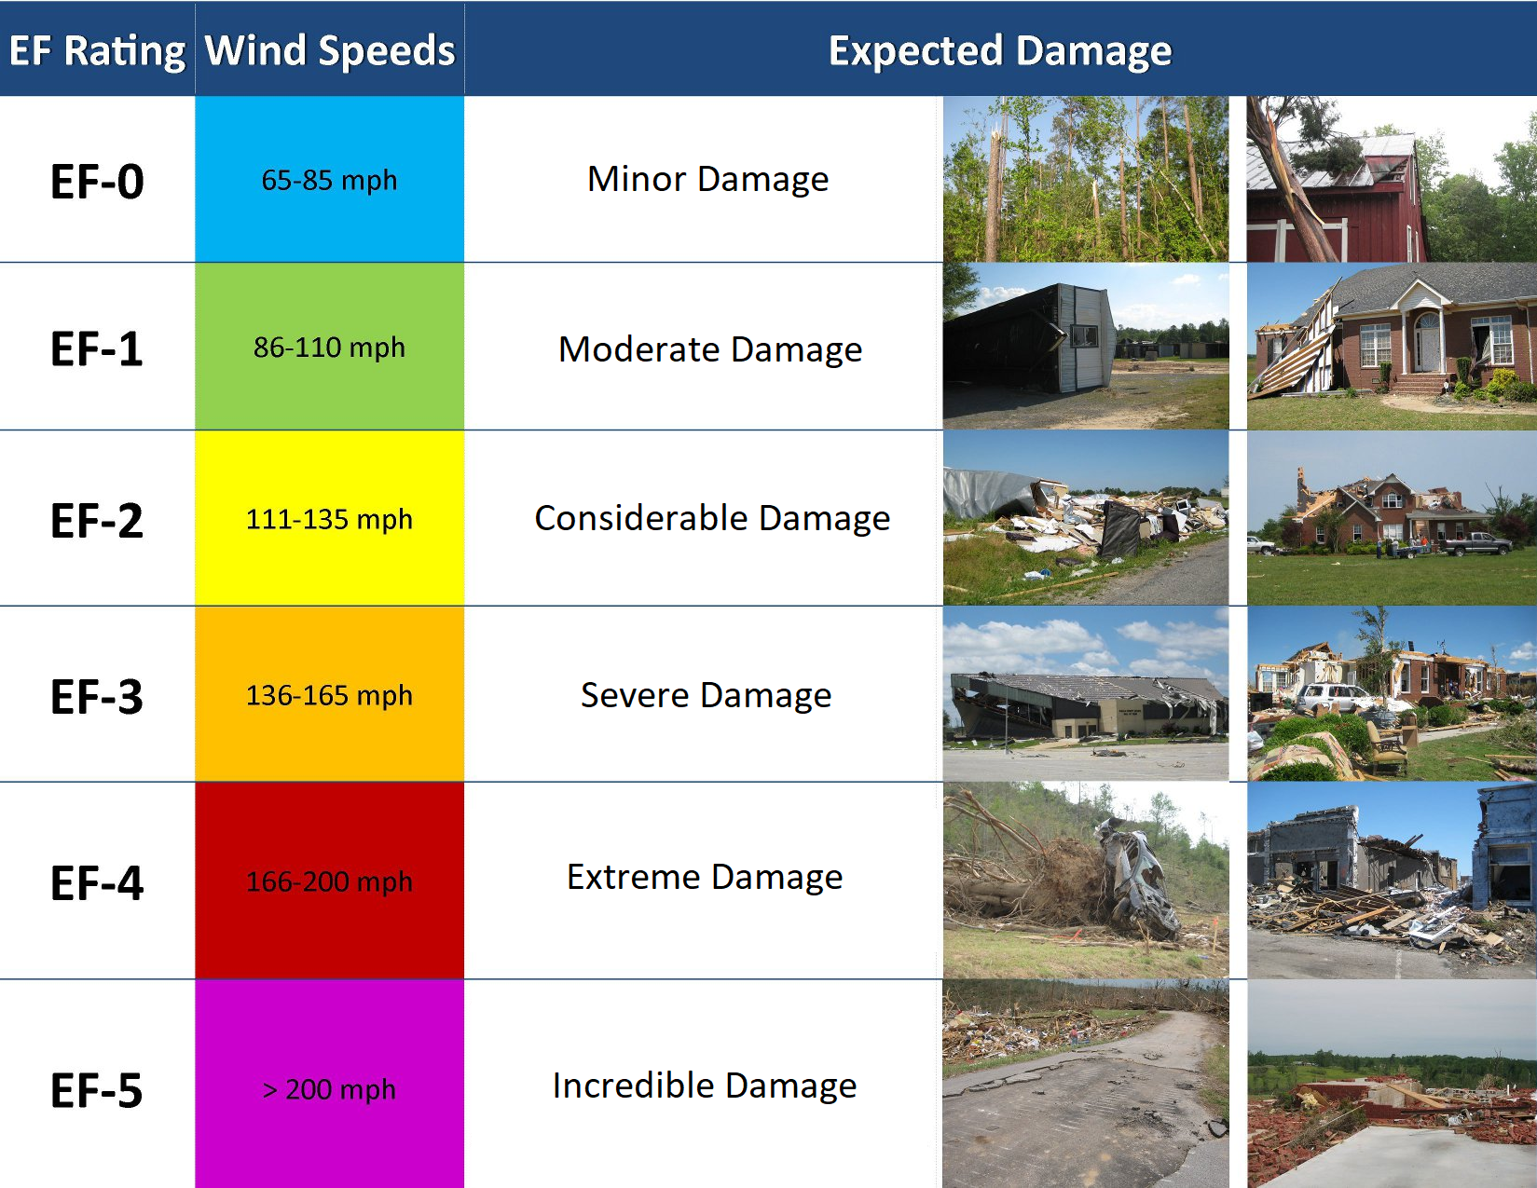
Tornadoes Are Classified On The Pearson-Fujita Scale (EF-0 to EF-5)

Slide 2
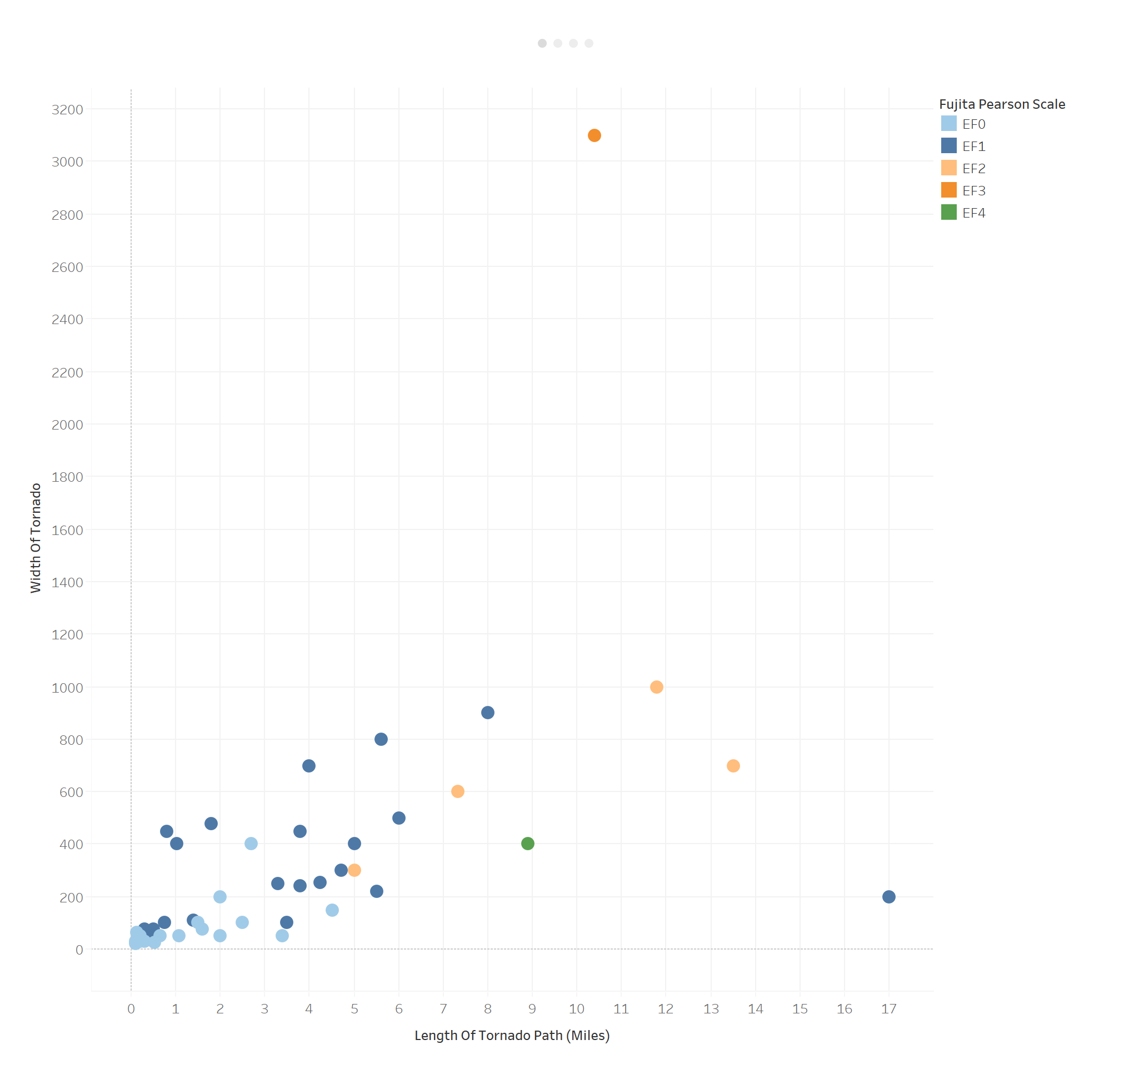
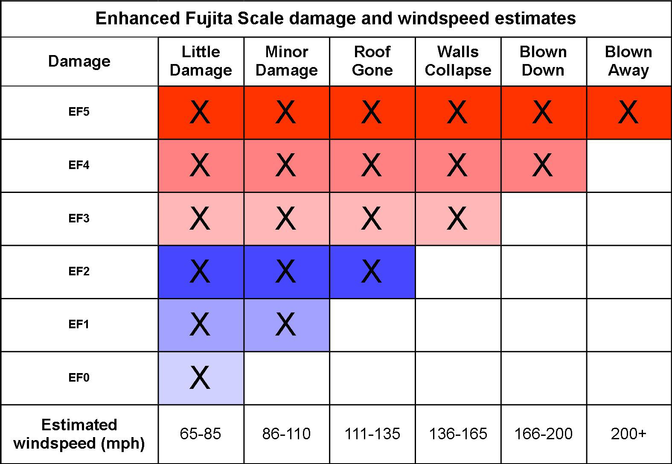
A tornado’s width and path length are good indicators of damage, but smaller tornadoes with faster windspeeds can cause more damage than larger ones.

Slide 3
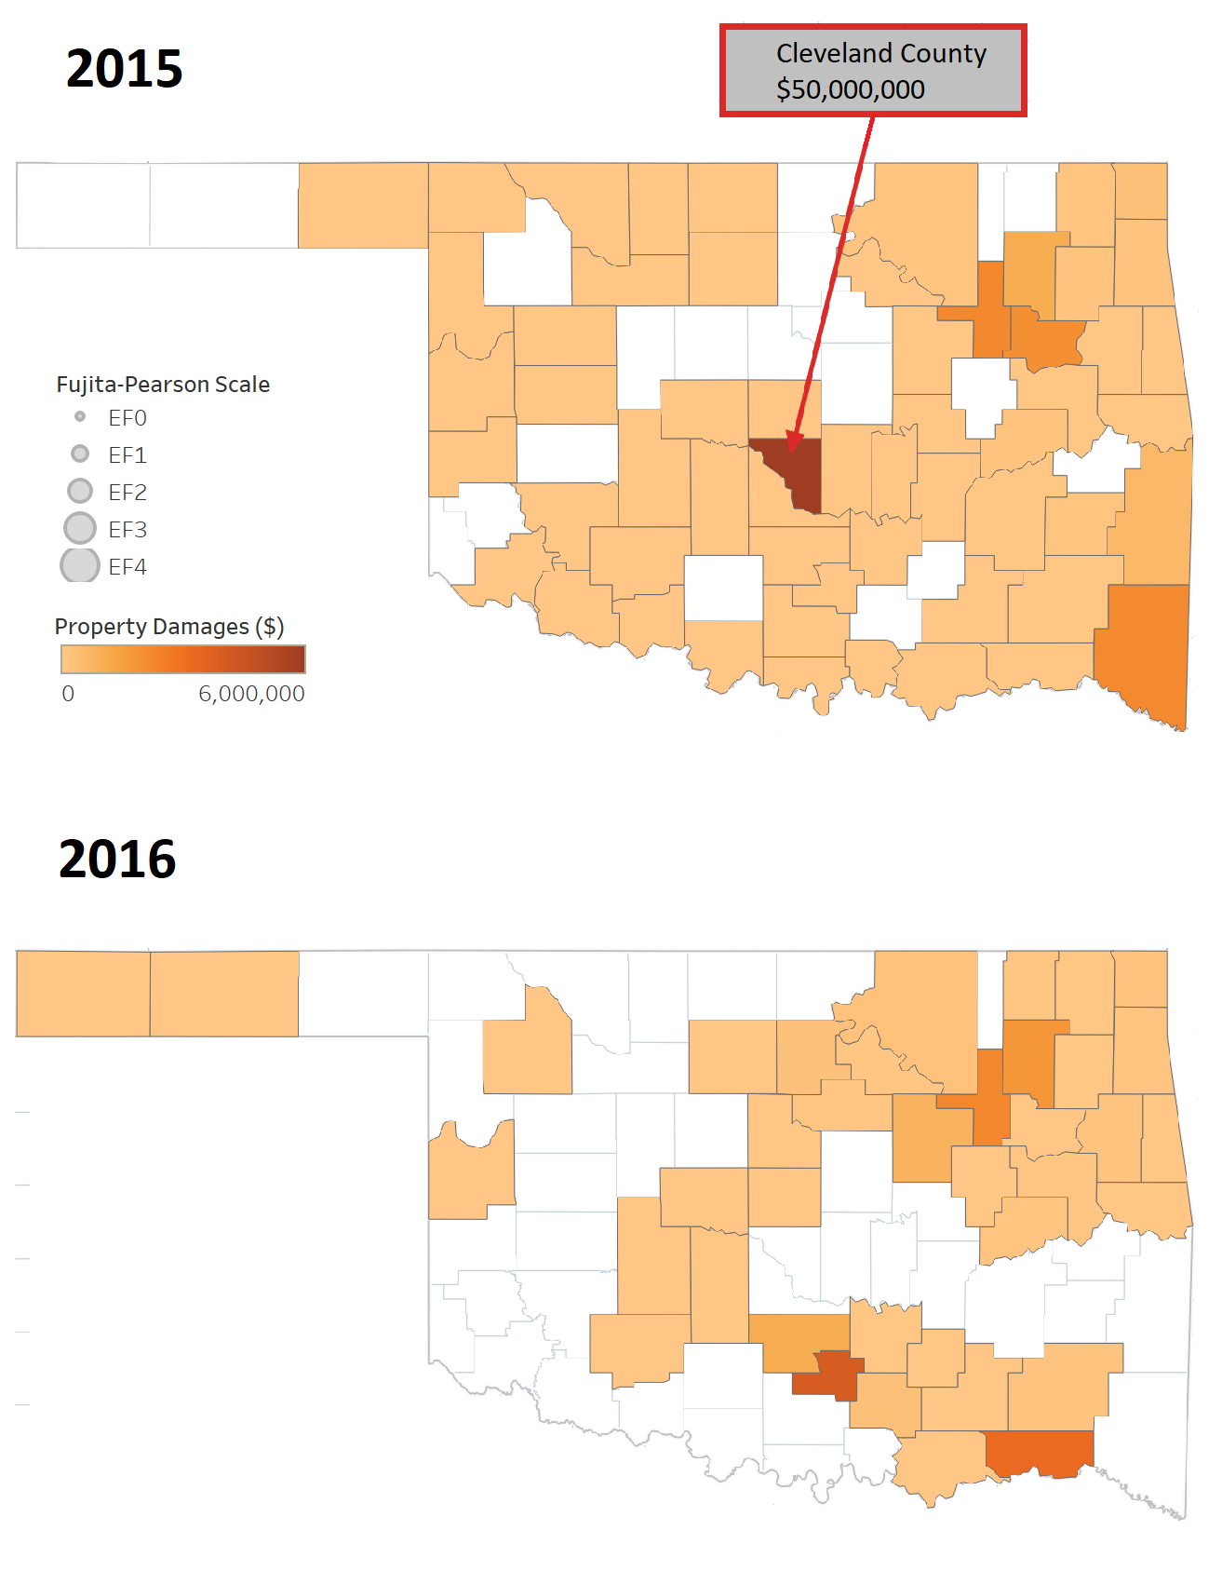
Property Damage Statistics

Slide 4
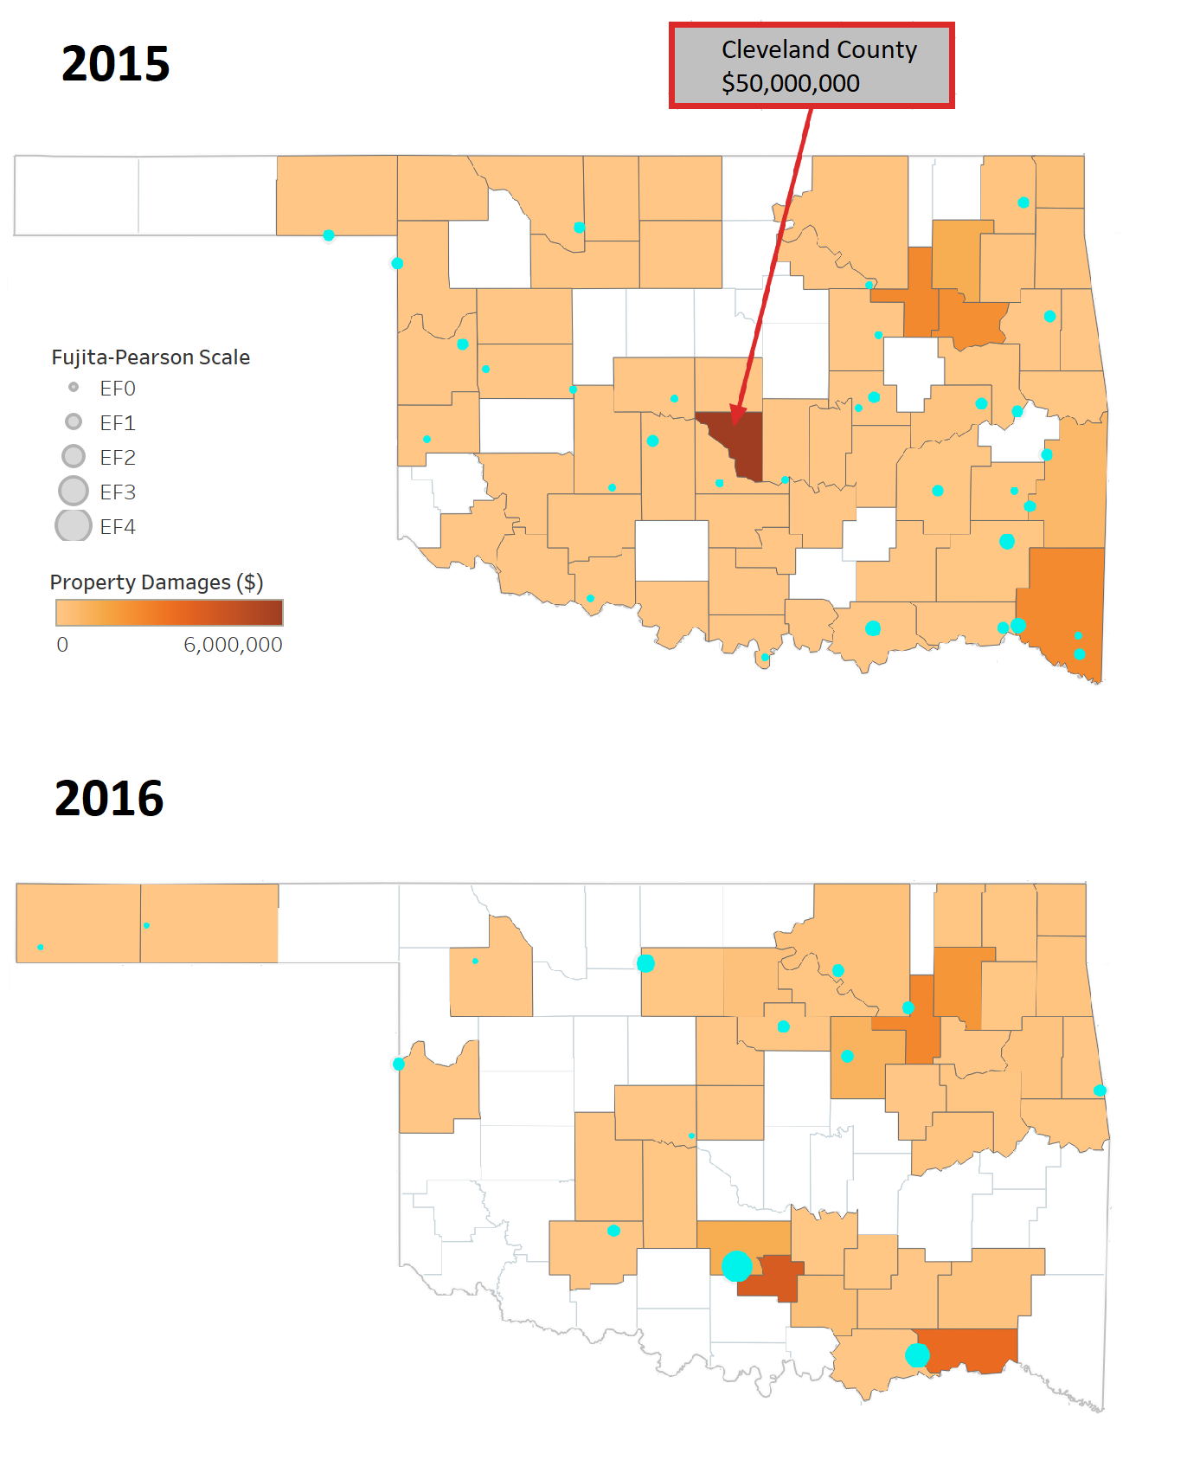

Slide 5
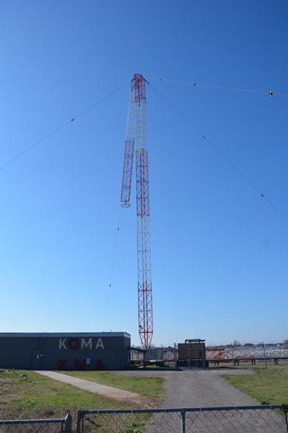
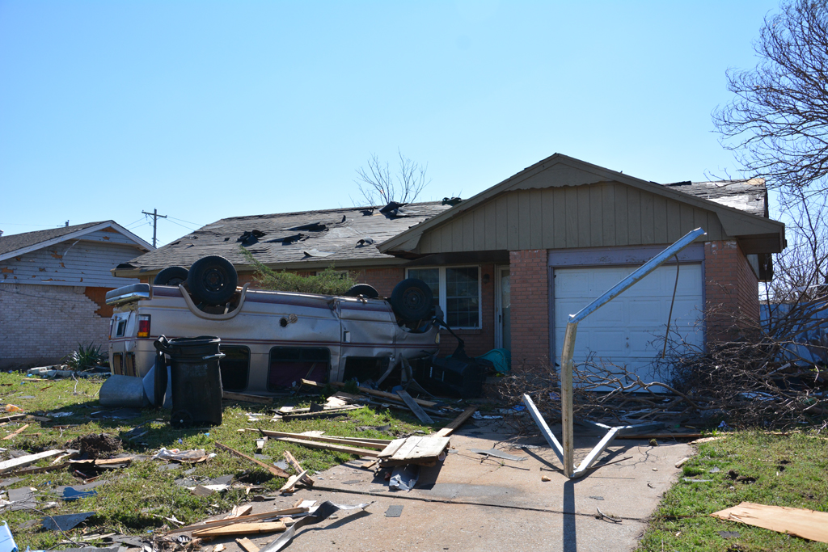
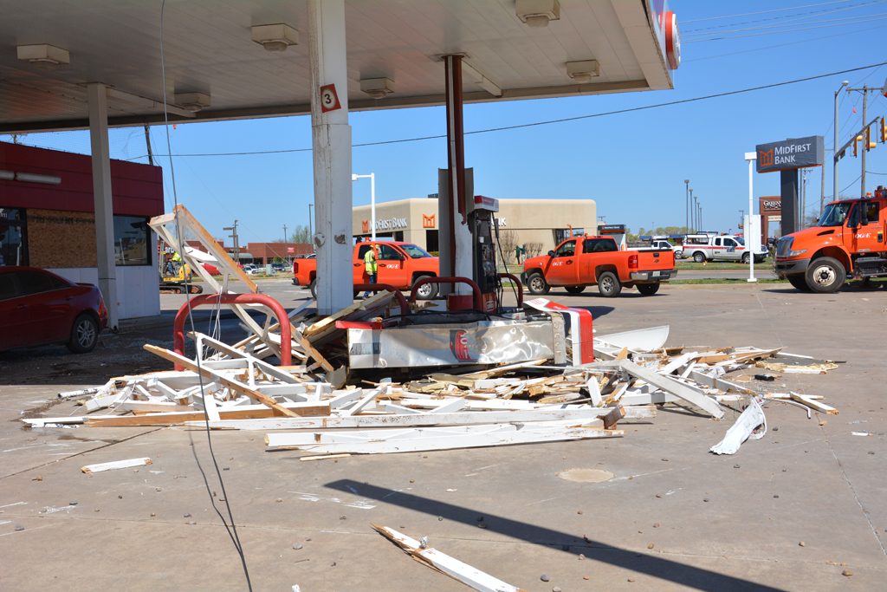
Cleveland County, March 25, 2015

Slide 6
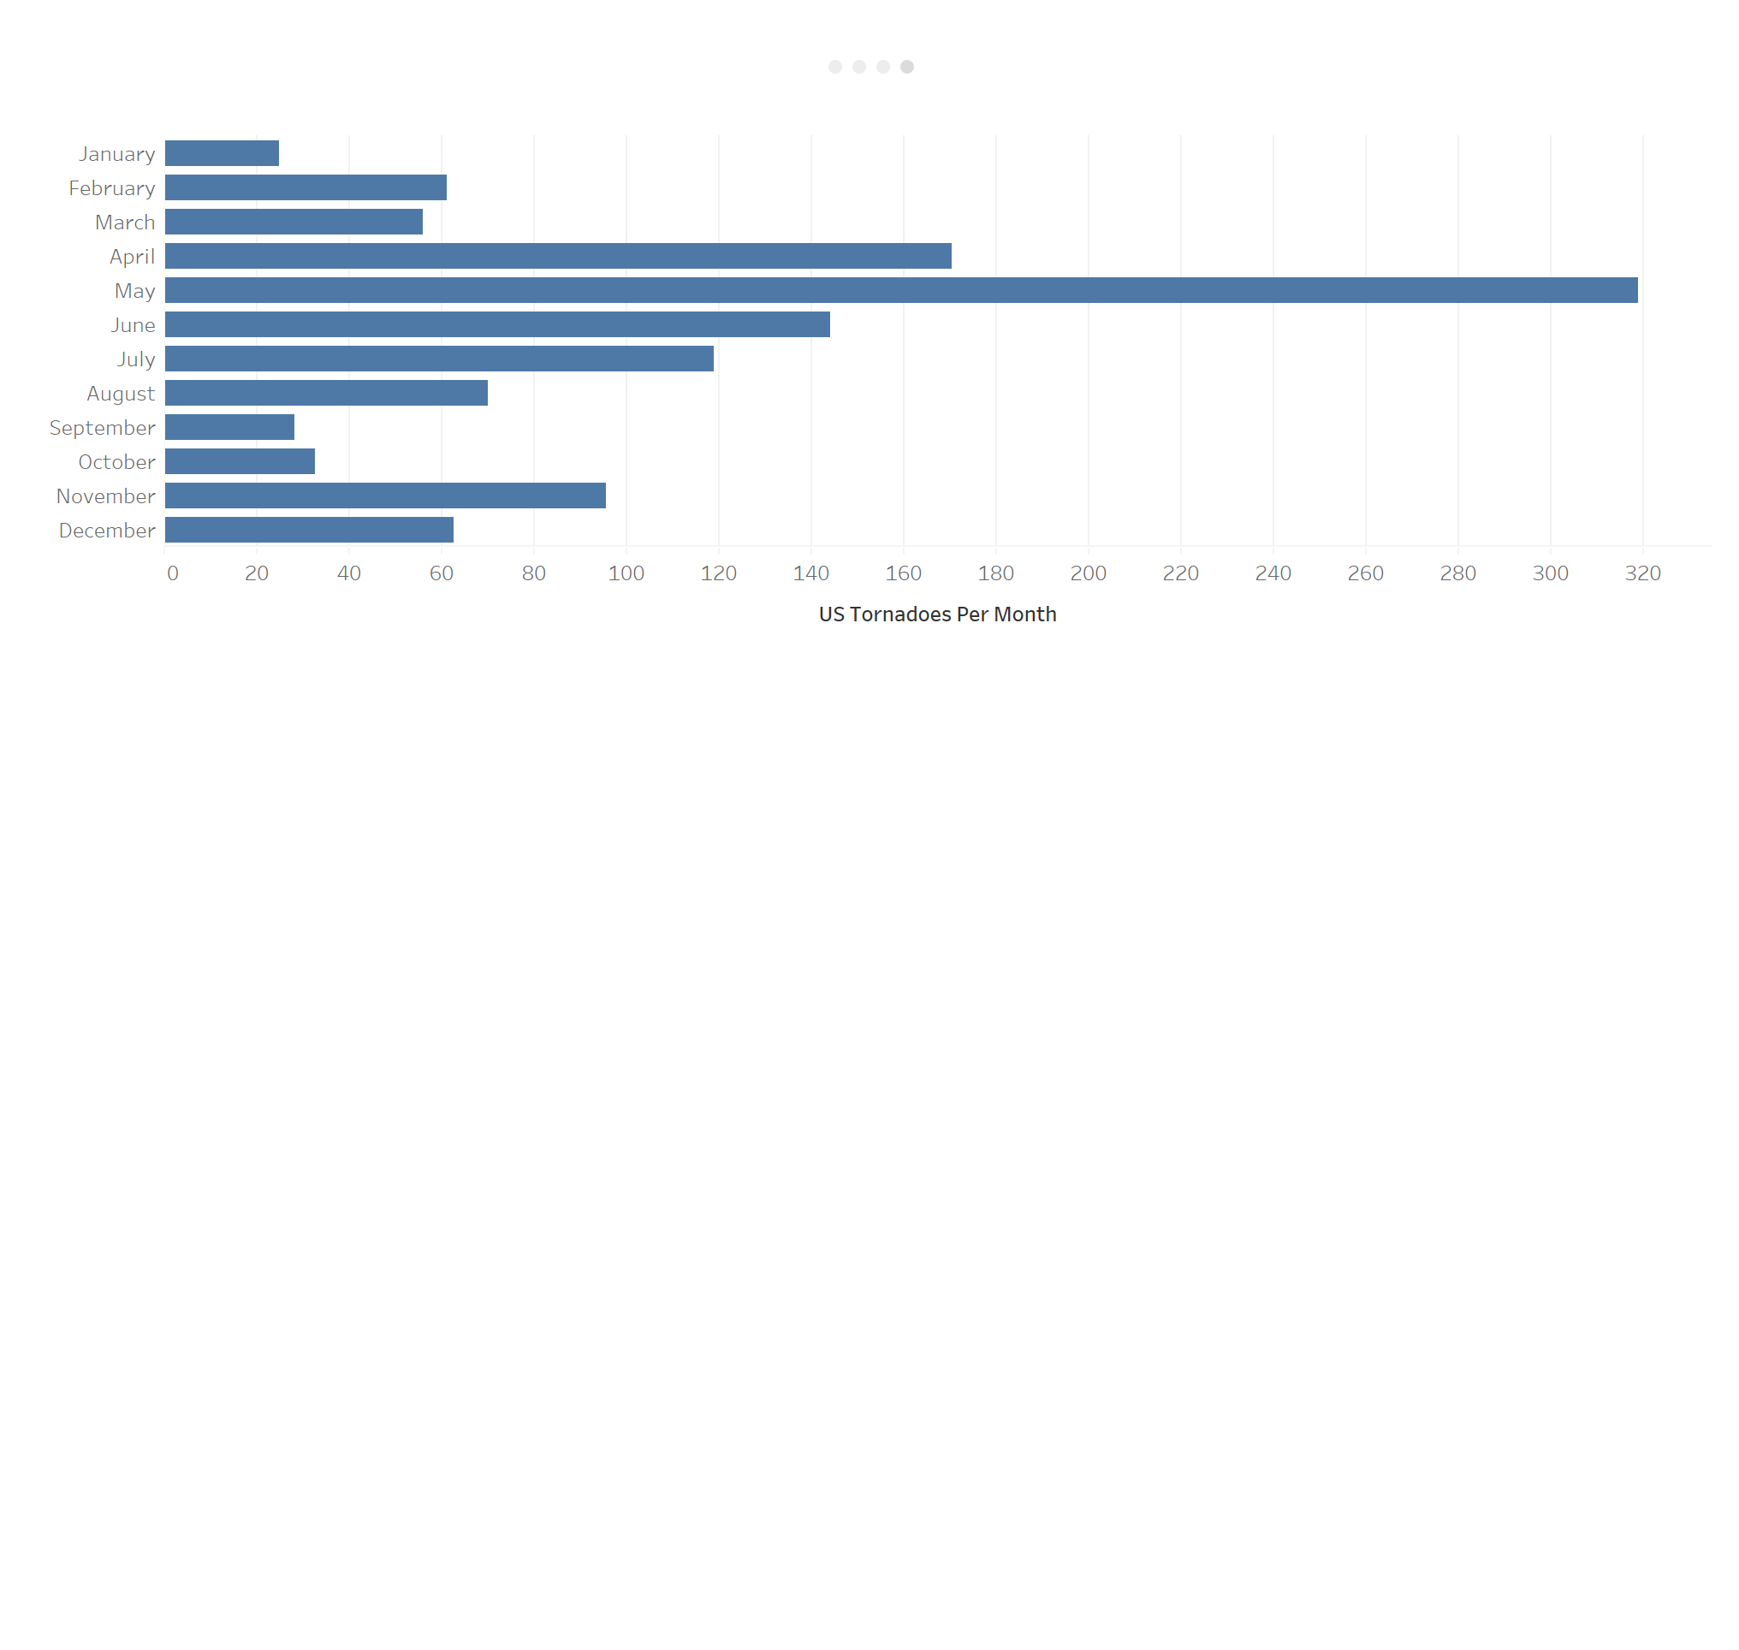




Peak Tornado Season
April – 14.4%
May – 27.0%
June – 12.2%
Total – 53.6%

Slide 7
Budget Recommendations

